Slide 1

Semester Project Final Presentation
Automated propeller geometry measurement
from 3d scanning data
LIS
Supervisors :
D. Floreano
S. Steffen
A. Bhaskaran
Author:
P. Maury Laribière
Notes:
Automation propeller geometry measurement
From 3D scanning data

Slide 2
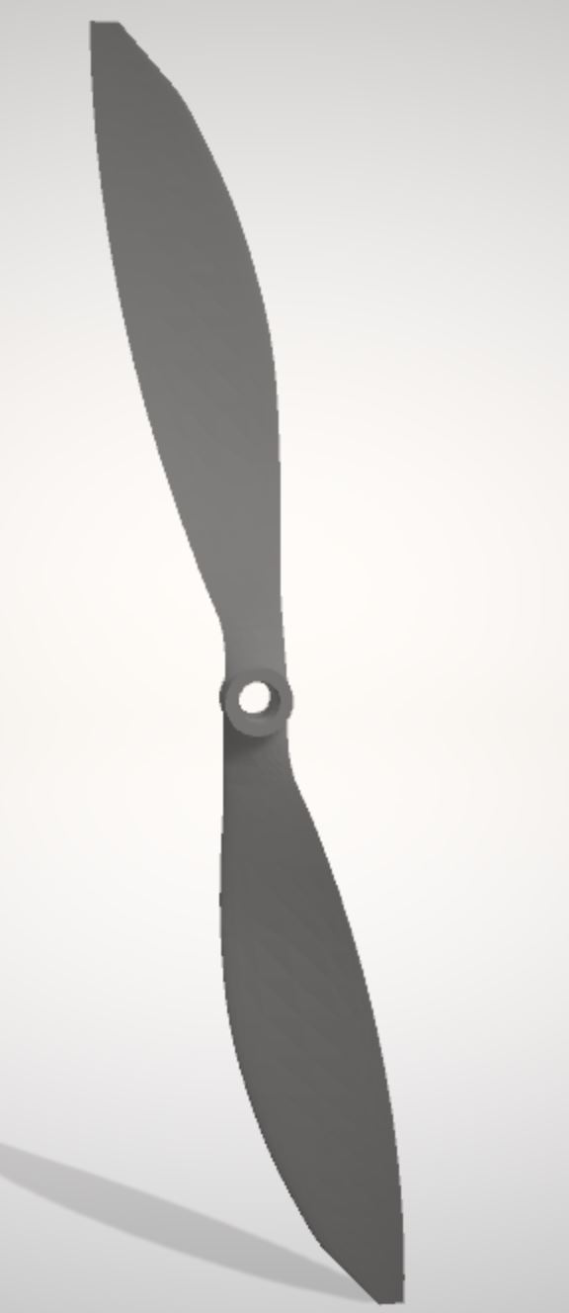
Summary :
Introduction
Initial concepts
Goal of the project
State of art
Methodology
Aerofoil shape
Parameters
Discussion
Conclusion
Notes:
First, introduce. Give prior info to understand following
Then, Methodology: 6 main steps
Discuss results and conclude

Slide 3
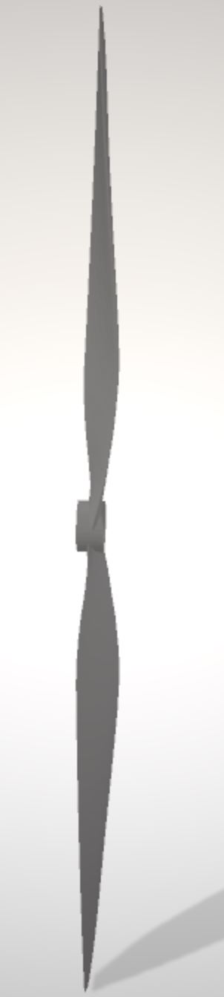
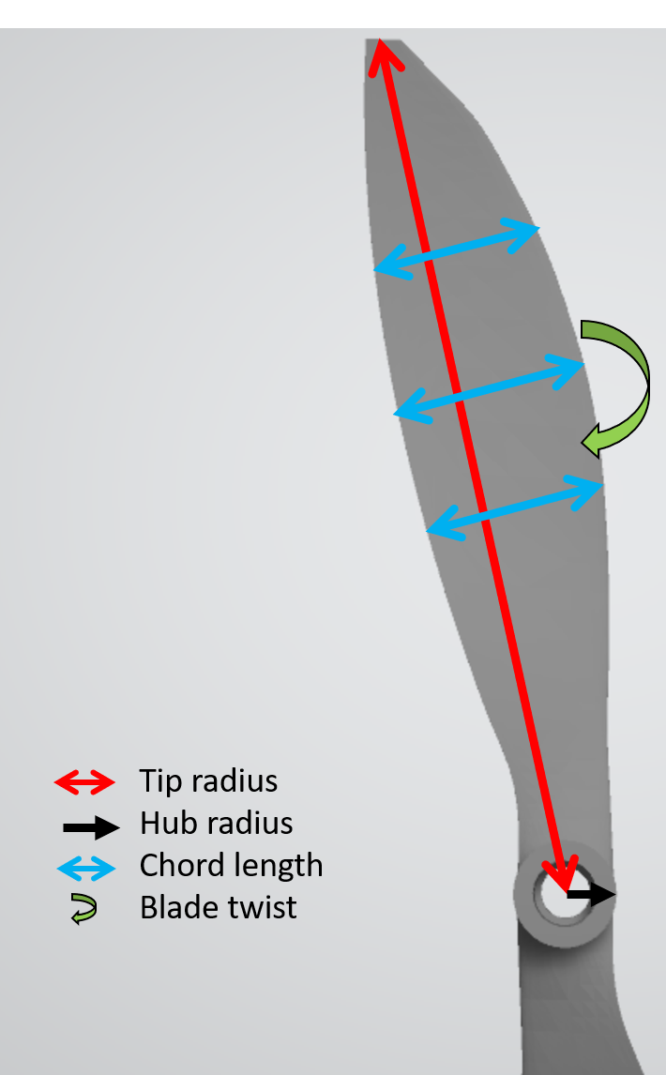
Introduction: Initial concepts
Geometric parameters of the blade
Aerofoil shape
Tip radius
Hub radius
Chord length
Blade twist
Aerofoil
cross-section
Notes:
Project with propellers.
Explain main terms will use for parameters
Aerofoil = cross sectionnal shape of blade
Chord length = length ; Blade twist = angle wrt hub ; tip radius = length blade ; hub radius: central hole

Slide 4
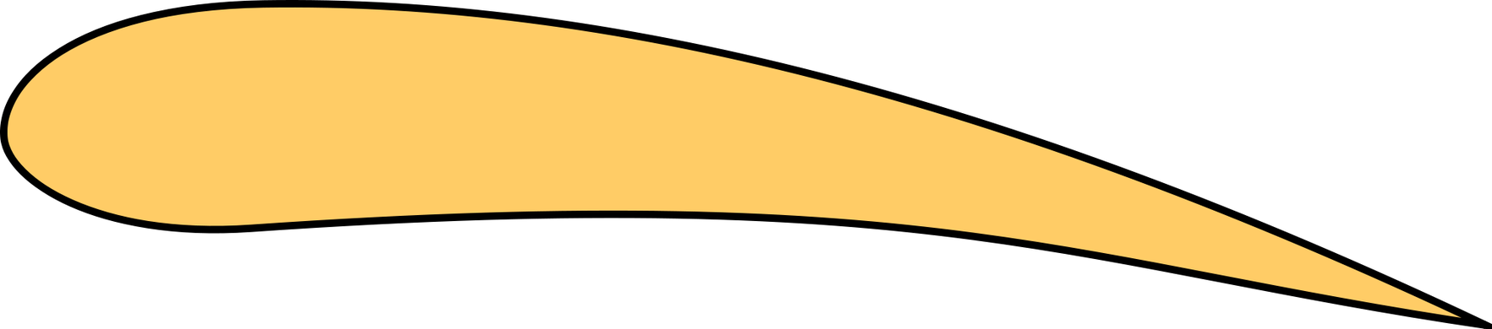
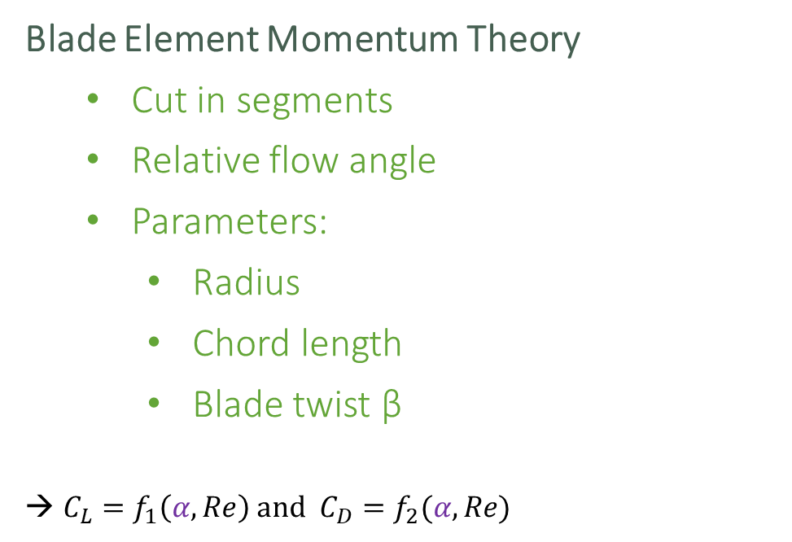
Introduction: Initial concepts
Blade Element Momentum Theory
Cut in segments
Relative flow angle
Parameters:
Radius
Chord length
Blade twist β
${C_{L}=f}_{1}\left(α, Re\right)$ and ${C_{D}=f}_{2}(α, Re)$
Lift
Air velocity
Drag
α = β - φ
β
φ
Rotation
Notes:
Nowadays drone perf analysis: BEMT.
cuts the propeller down into discrete segments along the radius
Estimate relative flow angle to blade segment WITH law conservation of momentum
Relative difference alpha of blade twist and air flow angle
→ Lift coeff: fct of alpha and Re
→ Drag coeff: fct of alpha and Re
→ Predict thrust and torques generated by segment by integrating over radius for all propeller
Method to predict performance of drone based on shape of propeller

Slide 5

Introduction: Goal of the Project
Goal :
Performance
Blade Element Momentum Theory
Shape
Solution
Problem :
Shape is not given
3D scanning
Notes:
GOAL: create a tool to analyze performance of drone
Usually drone analysis with:
1. Wind tunnels (not practical)
2. BEMT (need shape) → not easily available. Not published by manufacturers
NEED: propeller shape to understand performance of drone
IDEA:
3D scan propeller → obtain point cloud of its surface → compute parameters and aerofoil shape on based → enable to use BEMT

Slide 6
Introduction: State of the art
Choices for 3D Scanning:
1. Contact
2. Non Contact Active
3. Non Contact Passive
CMM
[1]
Structured Light
[2]
Time of flight
[2]
Laser triangulation [2]
Photogrammetry
[3]
5 main techniques
Notes:
Need a scanning method to generate point cloud. 5 main techniques to choose from
Contact : CMM: probe physically touches a firmly fixed object at several points and samples the different positions of the surface
Non contact active ----- rely on the emission of radiation or light.
Structured Light: a pattern of light. Measuring deformation of pattern on the object: shape deduced
Time of flight: Laser beam projected onto surface. Collected by a sensor. ToF of laser beam between its emission and reception provides geometrical information
Laser triangulation: Depending on distance object, reflected light falls at angle on receiving element. Determining spot position, distance object-receiver computed
3. Non CP: Photogrammetry: reconstructs a 3D model object from 2D digital pictures taken at different angles (computer vision + computational geometry algo)

Slide 7
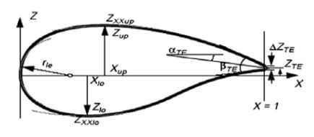
Introduction: State of the art
Cross section (= aerofoil shape) parametrisation
Bézier [4]
Parsec [4]
Bésier – Parsec [4]
Sobieczky (with PARSEC) [5]
Improved Parameter Geometric [6]
Exemple : Parsec parametrisation
Fig 5: PARSEC parametrisation parameters [4]
Notes:
Once scanning data, need to know how to parametrize aerofoil
Aerofoil = cross section
Many techniques which uses different features
Bezier: polynomials curves
Parsec parameters -- improved
Less parameters: IPG
Will try which is best to describe aerofoil obtained from point cloud

Slide 8
Methodology : Algorithm
Step 1:
Pre-processing
Step 2:
Points selection
Step 3:
Side assignment
Step 4 :
Curves interpolation
Step 5:
Parameters computation
Step 6:
Point output for Xfoil
Notes:
6 main steps overview
STEP 2: points selection: which points belong to which aerofoil ?
And then followed by this:
STEP3: to which side of the aerofoil do the point belong to ?
STEP4: following this step we can then use curve fitting tools to determine the optimal curve to describe the shape of our blade
STEP5:Optmial parameters of blade

Slide 9
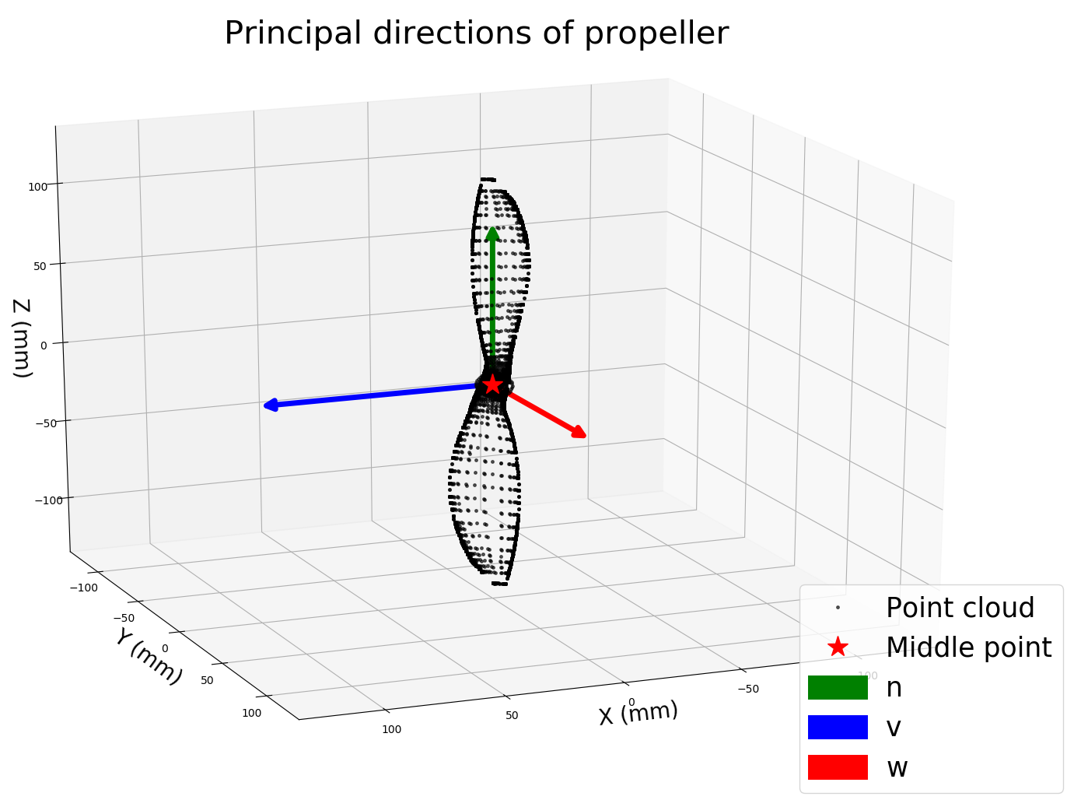
Methodology : Algorithm
Step 1: pre-processing
STL to CSV
Principal direction
Centering and rotating

Slide 10
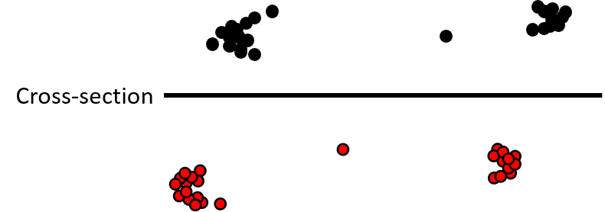
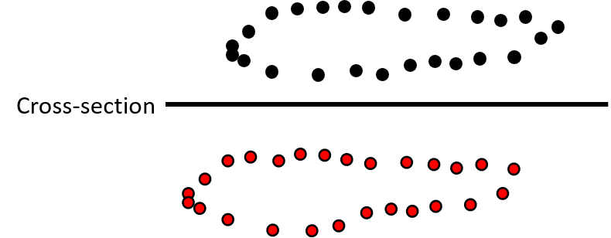

Methodology : Algorithm
Reality
Δ
Step 2: Points selection
Iterative algorithm
Accuracy change
Goal
$$w_{min}=\frac{chord}{40}$$
Notes:
To wich aerofoil do which point belong to ?
And through this, we did iterative algorithm
Accuracy changed

Slide 11
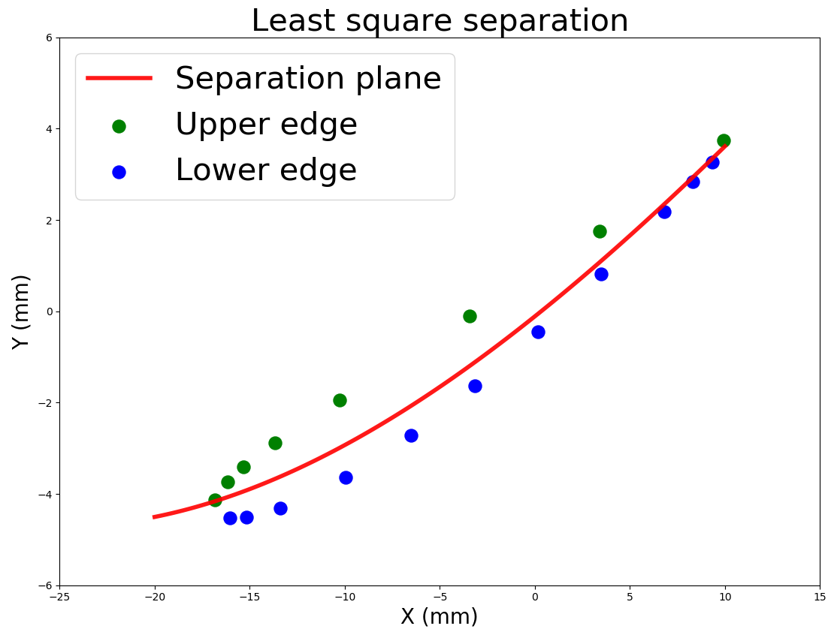
Methodology : Algorithm
surface
surface
Step 3: Side assignment
Least squares

Slide 12
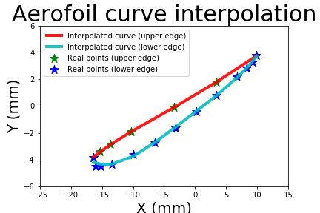
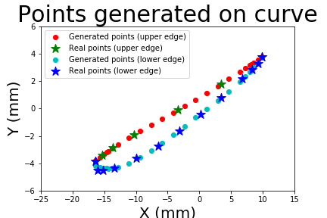
Methodology : Algorithm
Step 4: Curves interpolation (4th order polynomial)

Slide 13
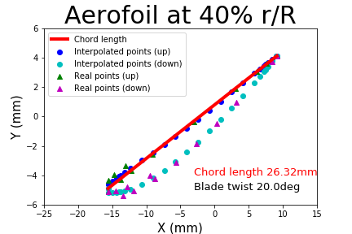
Methodology : Algorithm
Step 5: Parameters computation
Chord length
Blade twist
Notes:
Chord length: length ranging from 1 side of the aerofoil to the other

Slide 14
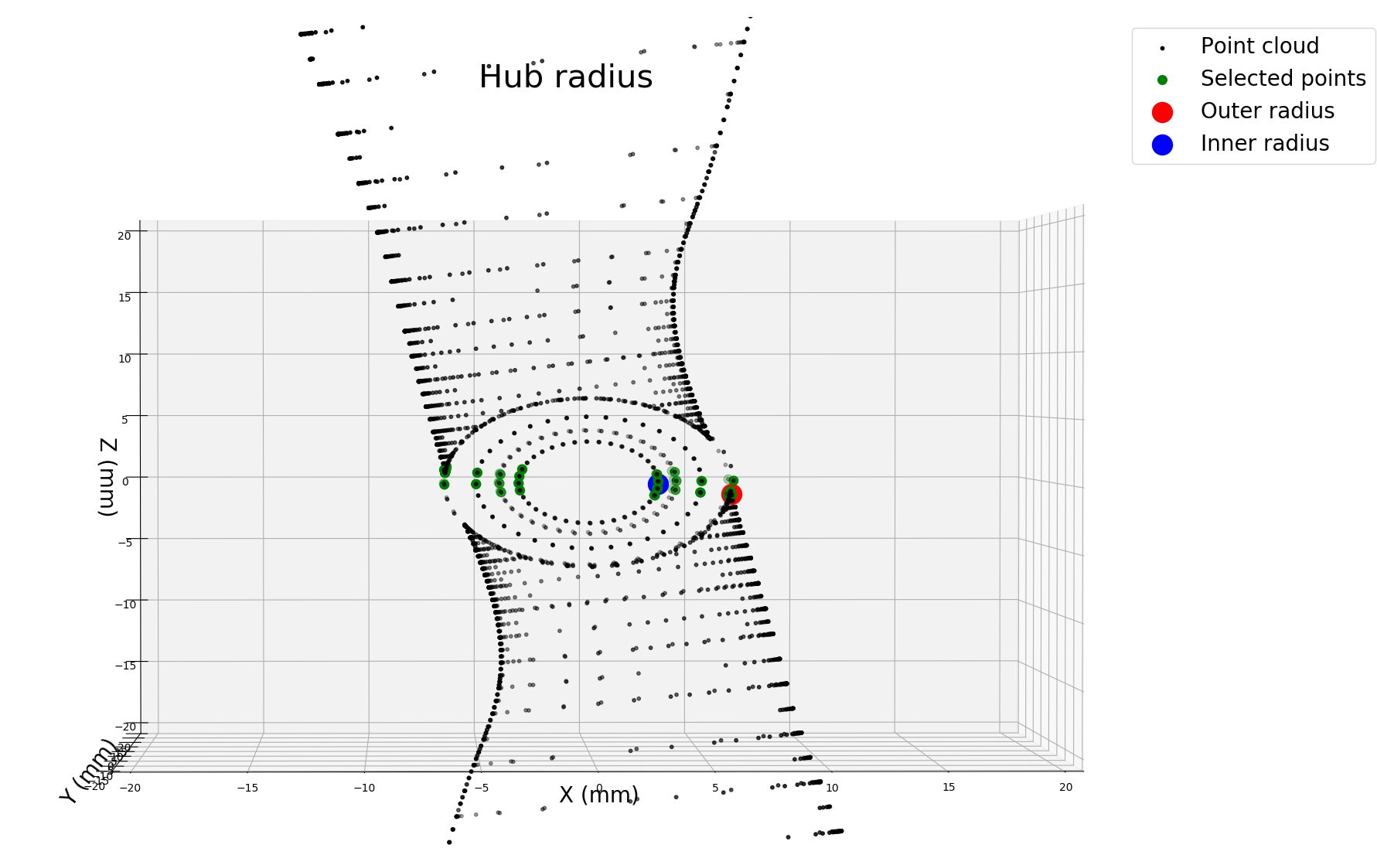
Methodology : Algorithm
Step 5: Parameters computation
Tip radius
Hub radius

Slide 15
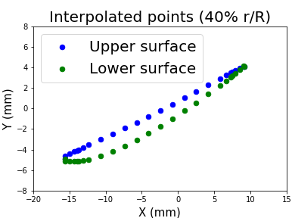
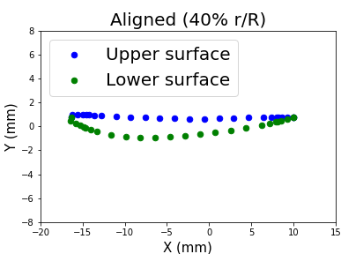
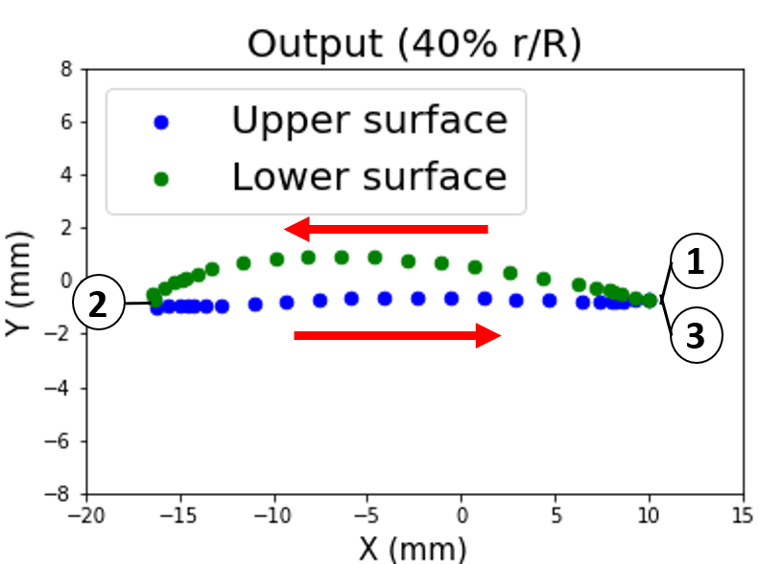
Methodology :
Step 6: X-Foil output
Align, mirror, (normalize), right order
Reynold and Mach

Slide 16
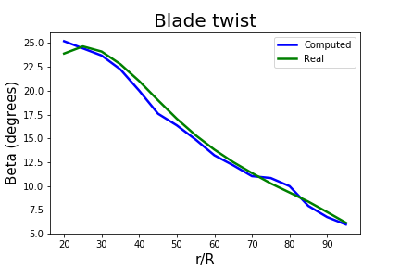
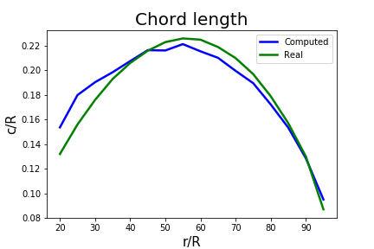
Results: Parameters
Chord length | Blade twist | Hub Radius | Tip Radius
RMSE 0.06 mm | RMSE 8.76 deg | Relative error | Relative error 0.19 mm
Notes:
To conclude,
Goal: compute interesting parameter and shape information of propeller from 3D scanning data to be able to use BEMT on it
Done.
Still projections
Then Xfoil and parameters
Optionnal: find processes to further automate the 3D scanning of the propeller using examples of tools available on the market

Slide 17
Results: X-Foil
No convergence in viscid mode
Could not compare with real parameters
Notes:
Unfortunately there is no convergence in viscid mode such that the parameters can not be found in xfoil

Slide 18
Discussion
Function choice
X-Foil not converging: continuity of both curves (?)
Scanning method
Photogrammetry
STL
Notes:
STL may be not the most appropriate format as the way it stores the shape of an object is through triangles. It leads to this problem where some parts are way more dense than others.

Slide 19
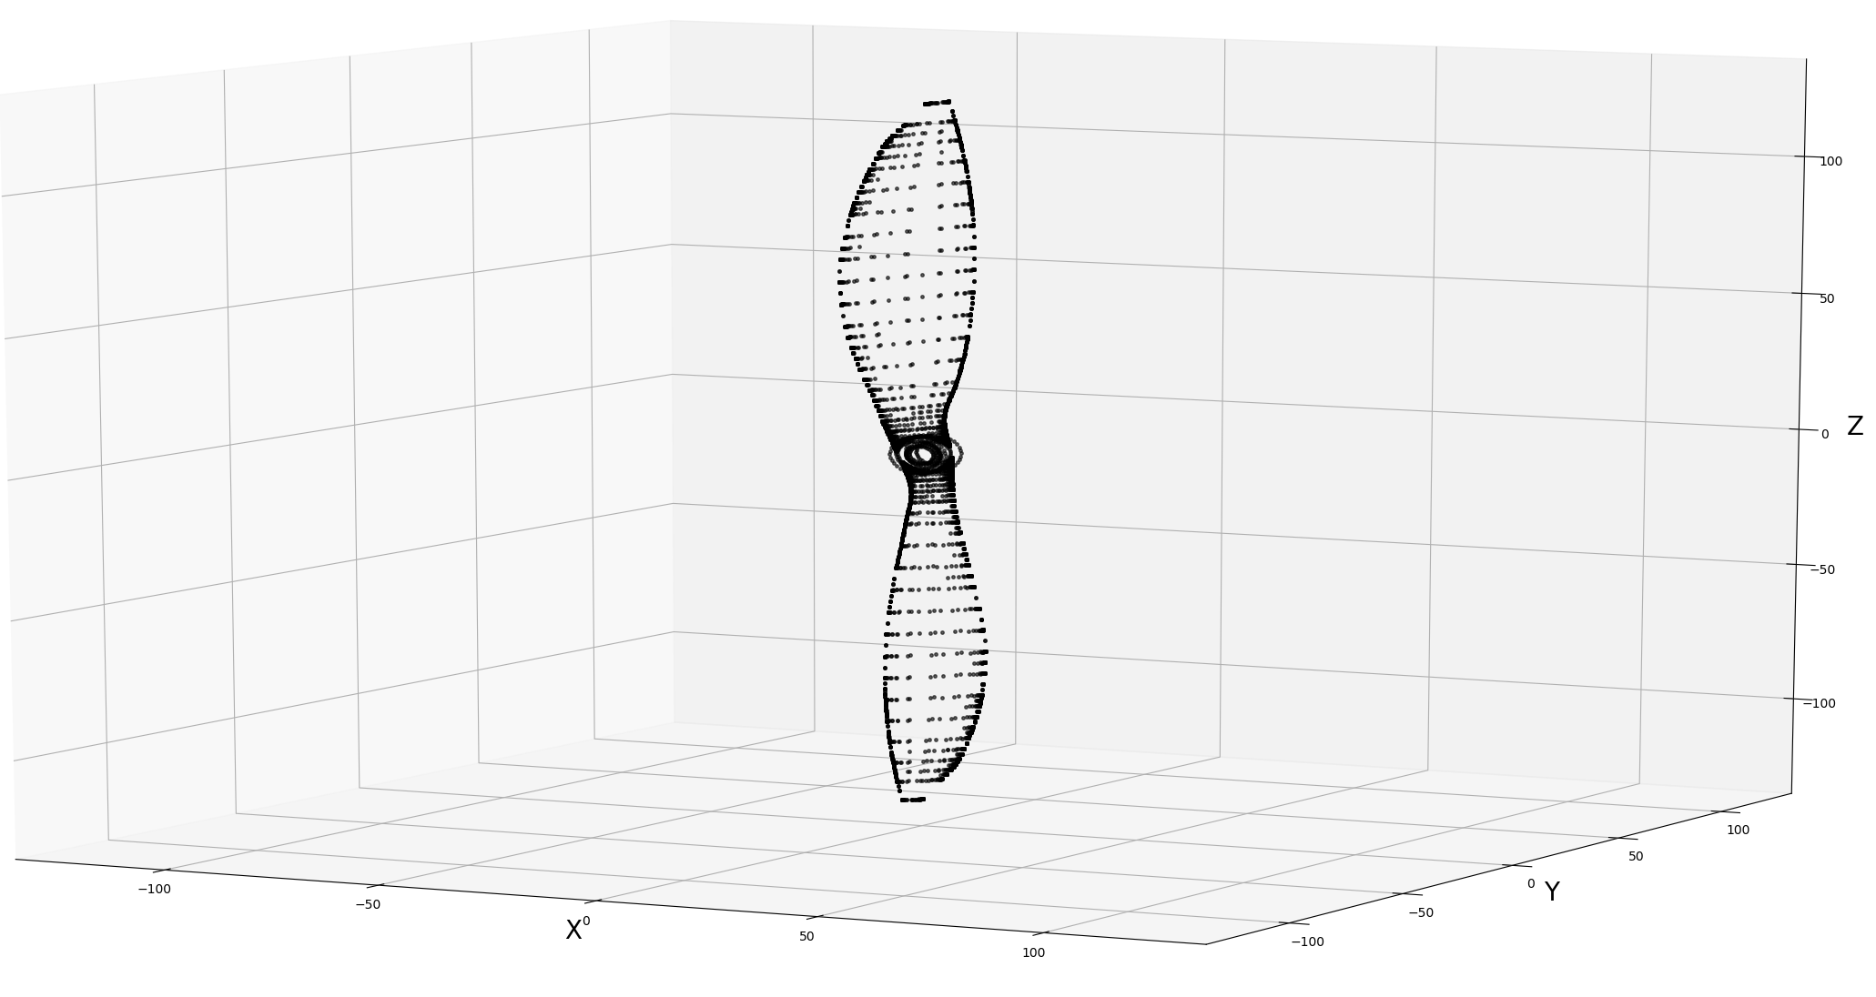
Conclusion
Reverse engineering algorithm
Propeller shape for drone performance analysis
Aerofoil shape
Parameters
Xfoil
Notes:
To conclude,
Goal: compute interesting parameter and shape information of propeller from 3D scanning data to be able to use BEMT on it
Done.
Still projections
Then Xfoil and parameters
Optionnal: find processes to further automate the 3D scanning of the propeller using examples of tools available on the market

Slide 20
Thank you for your attention

Slide 21
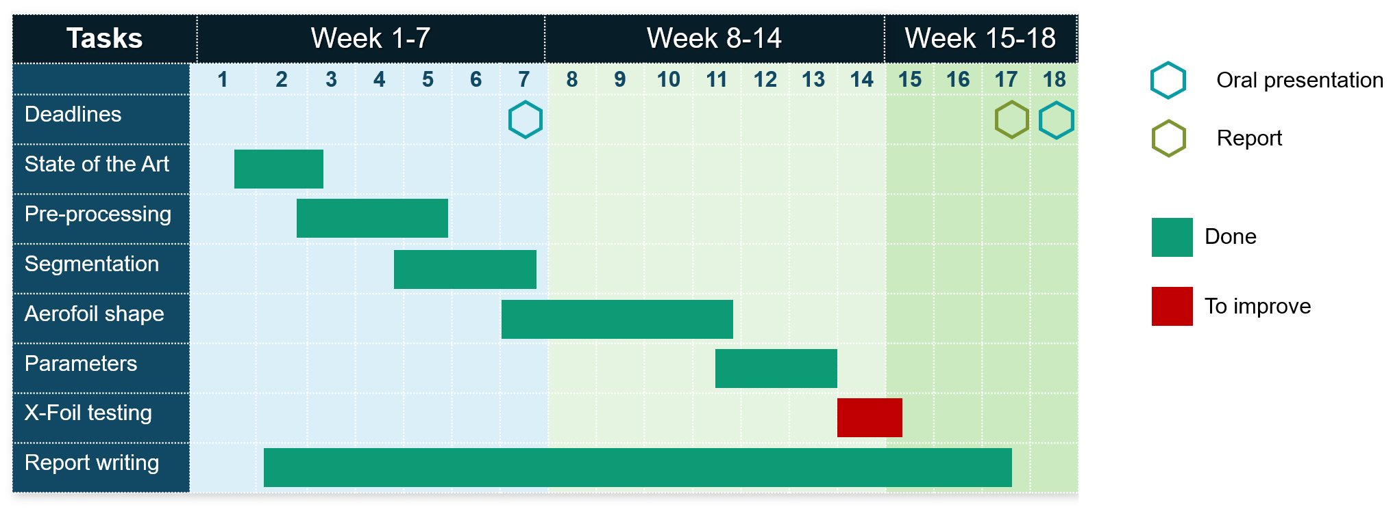
Gantt Chart

Slide 22
References
[1] A.W.L. Yao « Applications of 3D scanning and reverse engineering techniques for quality control of quick response products» Received: 2 October 2003 / Accepted: 27 January 2004 / Published online: 16 June 2004 © Springer-Verlag London Limited 2004
[2] Morteza Daneshmand, Ahmed Helmi, Egils Avots, Fatemeh Noroozi, Fatih Alisinanoglu, Hasan Sait Arslan, Jelena Gorbova, Rain Eric Haamer, Cagri Ozcinar, Gholamreza Anbarjafari. «3D Scanning: A Comprehensive Survey.» arXiv:1801.08863v1 [cs.CV] 24 Jan 2018
[3] Emmanuel P. Baltsavias. « A comparison between photogrammetry and laser scanning» Institute of Geodesy and Photogrammetry, Swiss Federal Institute of Technology, ETH-Hoenggerberg, CH-8093 Zurich, Switzerland Received 22 October 1998; accepted 17 March 1999
[4] Salunke, Nilesh P., Juned Ahamad R. A., and S.A. Channiwala. "Airfoil Parameterization Techniques: A Review." American Journal of Mechanical Engineering2.4 (2014): 99-102.
[5] Ava Shahroki Alireza Jahangirian Airfoil shape parameterization for optimum Navier–Stokes design with genetic algorithm. « Aerospace Science and Technology», Volume 11, septembre 2017
[6] Lu Xiaoqiang Huang Jun Song Lei Li Jing «An improved geometric parameter airfoil parameterization method.« Aerospace Science and Technology, Volume 78, July 2018
[7] from https://i.stack.imgur.com/Wo8E2.jpg
[8] from Ghassemi, H., & Zakerdoost, H. (2017). Ship hull–propeller system optimization based on the multi-objective evolutionary algorithm. Proceedings of the Institution of Mechanical Engineers, Part C: Journal of Mechanical Engineering Science, 231(1), 175–192. https://doi.org/10.1177/0954406215616655

